Slide 1

Mini Banking System
SIMBA MINI BANK
GROUP TWO DAY CLASS

Slide 2
What is SIMBA MINI BANK?
Simba Mini Bank is a windows based terminal banking platform that allows users to create accounts, deposit and withdraw money.

Slide 3
How to get started with Simba!
When you run the SIMBA MINI BANK program, it displays a menu where you can select create account, log in or see help page.

Slide 4
New user!
If you are a first time user, select create simba account and follow the prompts.

Slide 5
Friend Already!!
If you already have a SIMBA account already, select option 2 and follow prompts to login.
Once you have created an account or logged in, a menu will be displayed for yout to select the transactions you want.

Slide 6
What’s on the plate!
Deposit money to your account.
Withdraw money from your account.
Change my account details anytime.
With SIMBA, you have a number of options.

Slide 7


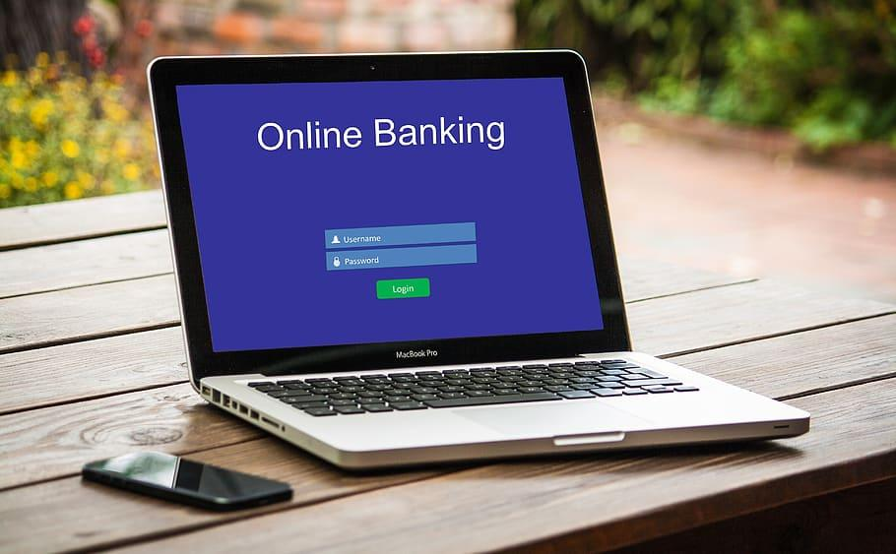
Group 2 day Meet The Team
Behind SIMBA MINI BANK is a dedicated and hardworking team and biomeds and mechatronics engineers from Kyambogo University.
Mandre Ajax, Marina K, Haggai E, Alpha AA, Gilbert M

Slide 8
What’s For The Future?
SIMBA MINI BANK updates will add more way more features.
Peer to peer money transfer
Getting loans
Viewing full transaction history
Investing in SIMBA projects where you account can be credited from interests.

Slide 9
Embrace digital banking, embrace SIMBA now.

Slide 10

SIMBA MINI BANK.
GROUP TWO DAY CLASS

